Slide 1
Web Spider
Tiancheng Fan

Slide 2
What is Web Spider
is an Internet bot that systematically browses the World Wide Web
And get data from WWW

Slide 3
About web

Slide 4
Aim of Spider: get the top 100 moves’ data from Maoyan
Get url from website
Find what I need
Save the data in txt

Slide 5
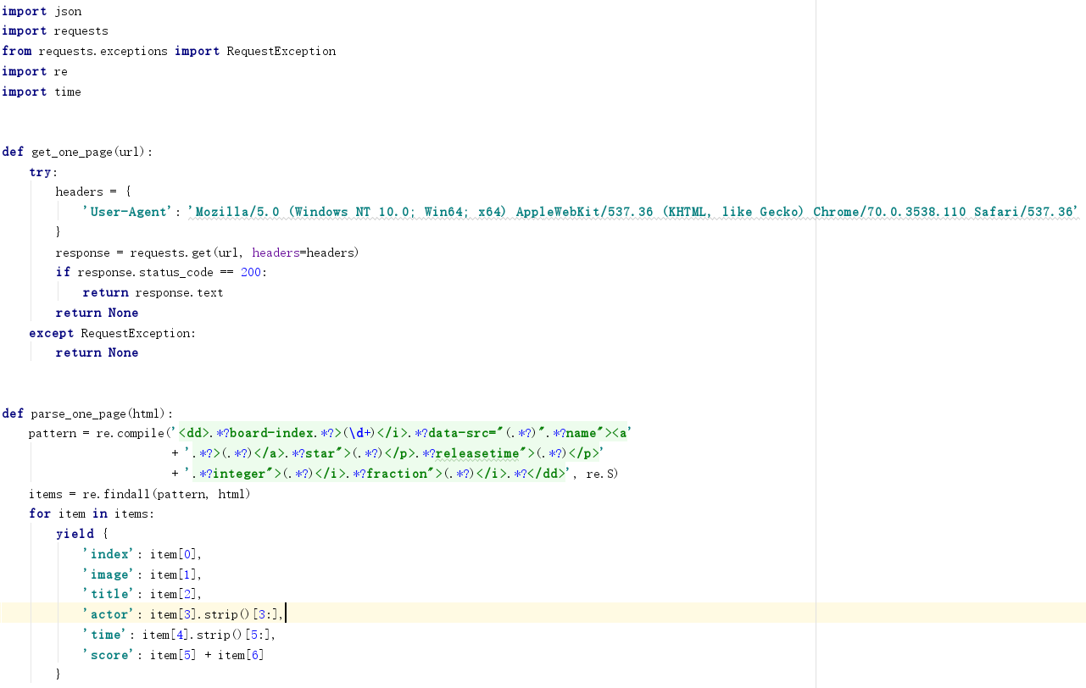
Talk is cheap
I will show you the code

Slide 6
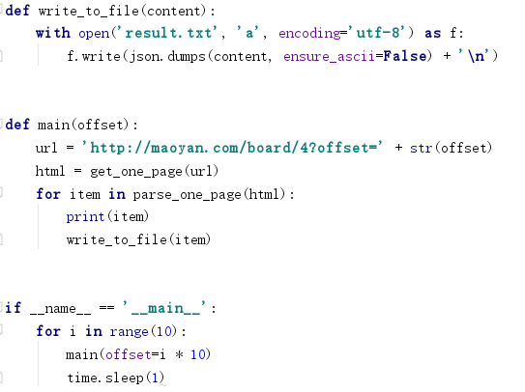

Slide 7
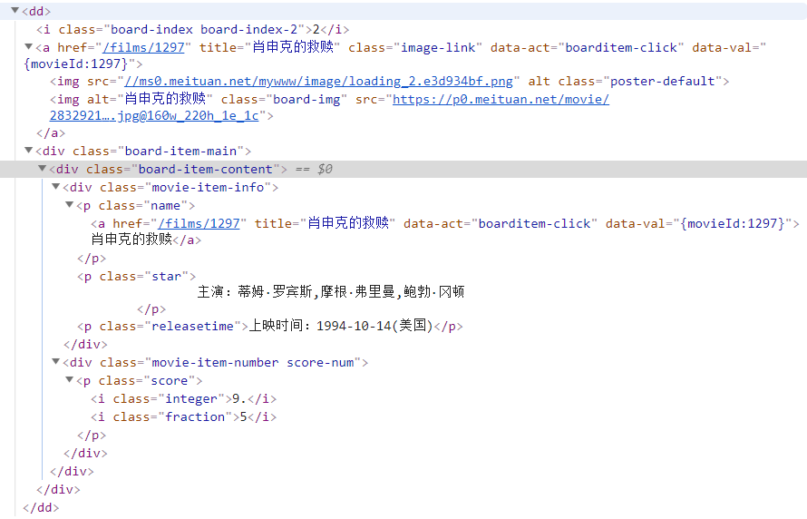

Slide 8
Problems I Met：
Do not know headers
Do not know Jason

Slide 9
What I Can Do Next：
Use database to keep data instead of txt
Use beautiful soup to clean data
Use pool to do multiprocessing
Maybe analyze the data

